Slide 1



INTERNSHIP REPORT
By Sai Pranay Deep

Slide 2

PROJECT GOALS
1.
Event Information sentences Extraction from Long-form Textual Data(monologues)
Article
Sentences
2.
Extract the Event Information from the sentences extracted above
Sentences
Event Details
Title
Date/Time
Location
02

Slide 3
PROBLEM STATEMENT - 1
We have long-form articles or monologues that need to be reduced into a few sentences, making them easier to input into a large language model (LLM) for further processing.
Sample Input:
Sample Output:
The Tech Summit is going to happen.
Come and Join. It is at Cafeteria. We will have fun.
The Tech Summit is going to happen. → Title present
Come and Join. → No useful information
It is at Cafeteria. → Location present
We will have fun. → No useful information
The Tech Summit is going to happen.
It is at Cafeteria.
03

Slide 4
Approach - 1 : Semantic Search
We will use a set of base sentences representing key information such as the title, date/time, and location. Each sentence in the article will be compared to these base sentences using a cosine similarity. If the average similarity score of a sentence exceeds a predefined threshold, the sentence will be retained; otherwise, it will be discarded. This approach helps filter out irrelevant or less important content, focusing only on sentences closely aligned with the core information.
Sample Base Sentences:
Title
Location
Date/Time
announces the event
invited to the party
hosting the event
Location of the event is delhi
Where it happens?
location
address
venue
Date of event
Time of program
will held on 27th August 2025
on Thursday morning
at 9 o clock
starts at 10 AM
04

Slide 5
Cosine Similarity
} 0.313
Date of the program is 01 Jan 2004
The Tech Summit is going to happen on 17th July
} 0.05
Date of the program is 01 Jan 2004
Don’t miss this
} 0.393
Announces the event
You are all welcomed to Tech Expo
} 0.09
Date of the program is 01 Jan 2004
Please have dinner
05

Slide 6
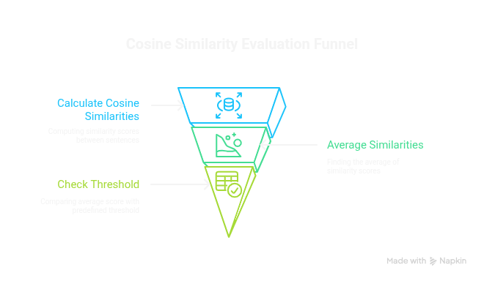
06

Slide 7

Accuracy Calculation
Article
Article
Req Output
1
2
3
4
5
6
7
8
9
10
11
12
13
14
15
16
1
2
5
6
8
10
Let required output should contains sentences (1, 2, 5, 6, 8, 10)
(1, 2, 5, 6, 7, 8, 10, 11) ✓ (1, 5, 6, 7, 8, 10, 11) X 2 is missing
If the predicted output contains all required sentences, then prediction is correct.
Otherwise prediction is wrong
Accuracy = correct predictions / Total samples
07

Slide 8
Model Comparision
MiniLM
LaBSE
~82% accuracy with noise
~5-10 extra noise sentences
~84% accuracy with noise
~5-10 extra noise sentences
Accuracy
Size
~27M parameters
~80MB
~470M parameters
~1.8GB
Speed
Fast
Slow
08

Slide 9
Approach - 2 : Fine-Tuning a Binary Classification Model
We build a database of event-related sentences. Each sentence is evaluated to determine whether it contains key event information such as a title, date/time, and location.
Sentences that include any three components (title, date/time, and location) are labeled with a 1.
Sentences that are missing all of these components are labeled with a 0.
Using this labeled dataset, we fine-tune a binary classification model to automatically identify sentences that contain complete event information.
Sample Sentences:
The Startup Pitch starts tomorrow at 11 AM, 1
1 as it contains title and time
Catch the Orientation Day live at Innovation Hub, 1
1 as it contains title and location
A celebration was traditional, 0
0 as there is no title, date/time, location
The ceremony proceeded smoothly with all participants engaged, 0
0 as there is no title, date/time, location
09

Slide 10
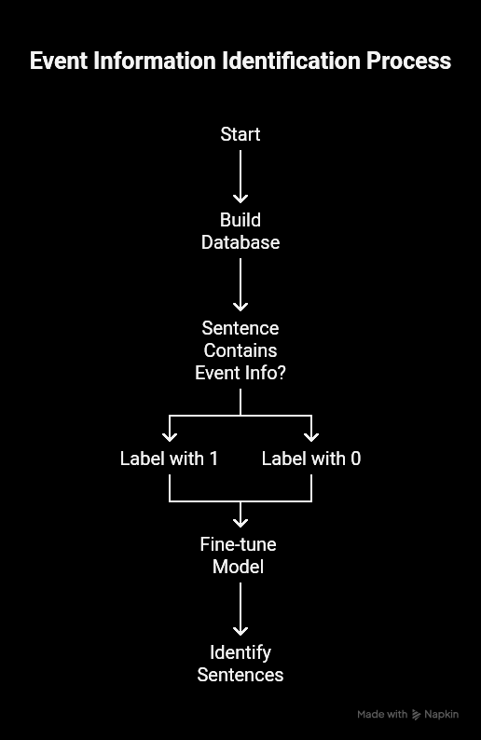
10

Slide 11
Dataset Used for fine-tuning a binary classifier
Prepared by | Ollama
No. of samples | 1069
Event info related | 574
Non Event related | 495
11

Slide 12
Approach - 2 : Fine-Tuning a Multi-label Classification Model
We build a database of event-related sentences. Each sentence is evaluated to determine whether it contains key event information such as a title, date/time, and location.
label = (x, y, z)
x = 1 if sentence contains title related information. Otherwise x = 0
y = 1 if sentence contains date/time related information. Otherwise y = 0
z = 1 if sentence contains location related information. Otherwise z = 0
Using this labeled dataset, we fine-tune a multi-label classification model to automatically identify sentences that contain complete event information.
Sample Sentences:
"Don't miss the Winter Wonderland on January 3rd, 2026 at Snow Park." - (1,1,1)
The Hip-Hop Poetry Night happens at The Urban Beat Café. -(1,0,1)
Be there for the introduction of our Game-Changing Platform. - (1,0,0)
"Brace for the Book Launch - happening on 29 August 2025, 7:45 AM." - (1,1,0)
Final segment concludes at 5:45 PM Friday. - (0,1,0)
Be there at Bengaluru Tech Park on 9:45 AM. - (0,1,1)
Don't miss us at Club Escape. - (0,0,1)
A demonstration changed perceptions. - (0,0,0)
12

Slide 13
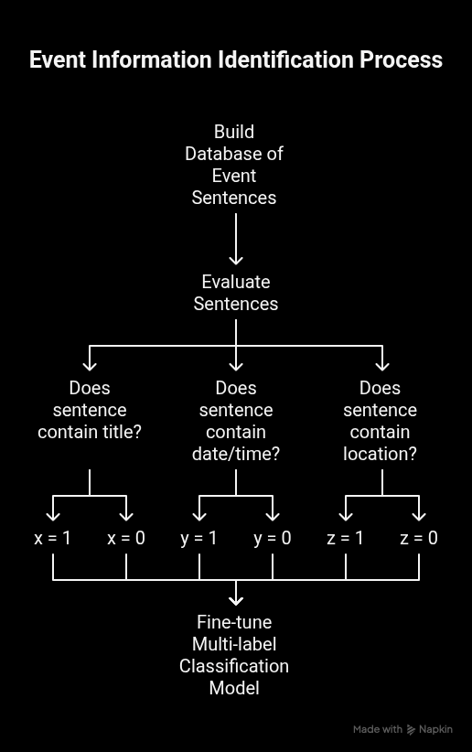
13

Slide 14
Dataset Used for fine-tuning a multi-label classifier
Prepared by | Ollama
No. of samples | 6411
Only Title containing sentences | 652
Only Date/Time sentences | 643
Only Location sentences | 455
Both Title, Date/Time sentences | 674
Both Title, Location sentences | 960
Both Date/Time, Location sentences | 520
All Title, Date/Time, Location sentences | 810
No related sentences | 1697
14

Slide 15
Approaches Comparision
Semantic Search | Binary Classifier | Multi-label Classifier
~84% accuracy excluding noise | ~90% accuracy excluding noise | ~96% accuracy excluding noise
Model size cannot be reduced | Model size can be reduced using quantization & distillation | Model size can be reduced using quantization & distillation
No training time required | 1hr+ training time required | 1hr+ training time required
No training data required | Training data required | Training data required
Output is automatically seperated into categories | Output should be separated into categories | Output is automatically seperated into categories
5-10+ noise sentences | 5-10 noise sentences | 3-7 noise sentences
15

Slide 16
PROBLEM STATEMENT - 2
We need to extract key event-related information — title, date/time, and location — from the sentences identified in the previous step.
Sample Input:
Sample Output:
Be there for the debut of our Industry-Disrupting Technology.
"Mark your calendar for the Coding Bootcamp on 30 September 2025, 11:45 PM."
Title : Industry-Disrupting Technology
Title : Coding Bootcamp
Date/Time : 30 September 2025, 11:45PM
16

Slide 17
Approach - 1 : Using Libraries
To Extract Time:
There are several libraries available for extracting date and time information from text. One of the most effective and widely used options is parsedatetime.
However, it does not perform well on certain edge cases. To address this, we incorporated additional fuzzy matching terms and custom handling logic, which significantly improved accuracy in those cases.
To Extract Location:
There are few libraries available for extracting location from text. But they can only extract locations like Countries, Cities but not general locations.
To Extract Title:
There are few libraries available for extracting location from text. But they can only extract locations like Countries, Cities but not general locations.
17

Slide 18
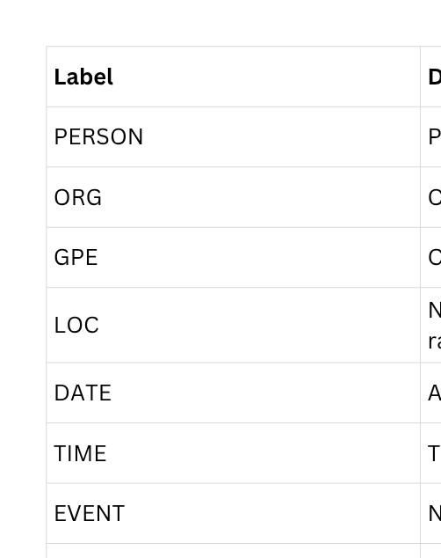
Using spacy
18

Slide 19
Approach - 2 : Using QNA Method
There are several models designed to answer questions based on a given context. One such model is distilbert-base-cased-distilled-squad, a lightweight version of BERT fine-tuned on the SQuAD dataset for question answering tasks.
In this approach, we use a set of predefined questions to extract the required information — title, date/time, and location. For each type of information, we provide a set of relevant questions, and the model returns the most appropriate answer based on the given context.
Set of
Questions
Answers
with confidence
Sentence
Best Answer
19

Slide 20
Example
You're invited to the Halloween Party in Grand Hyatt Mumbai.
What is the event title?
What is the name of the event?
What event is being described?
What is the title of this event?
Halloween Party
0.867
Halloween Party
0.924
Halloween Party
0.910
Halloween Party
0.861
Answer : Halloween Party
20

Slide 21
THANK YOU
21

